Slide 1
COMP6200 : Data Science
GROUP 5 PROJECT REPORT
DATA ANALYSIS ON HOUSE SALES AND RENT DATA IN NEW SOUTH WALES, AUSTRALIA
SUBMITTED BY:
Aarushi Chaudhary - 46113908
Ameer Ali Mavani - 46812342
Arnav Bajaj - 46806423
Kaveri Bhatia Chanana - 46282920

Slide 2
AGENDA
Problem Statement
Data Source
Data Manipulation and Cleaning
Exploratory Analysis
Linear Regression Model
KMeans Clustering
KNN Classification
Conclusion

Slide 3
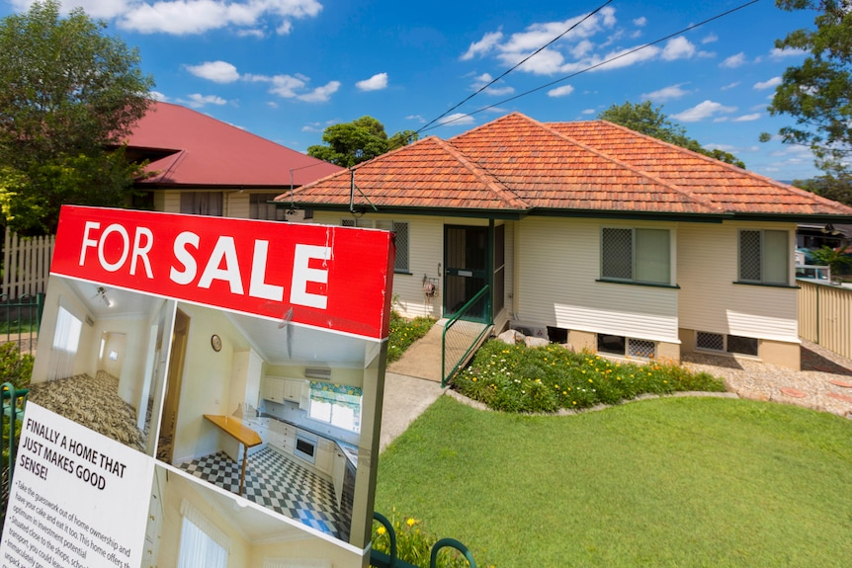
DATA ANALYSIS ON HOUSE SALES AND RENT DATA IN NEW SOUTH WALES, AUSTRALIA
PROJECT SUMMARY
The property market in New South Wales, particularly in Sydney, has been rising in recent years.
The cost has increased by nearly 15% in the last year.
As the number of individuals coming to NSW to study or work grows, everyone should be able to find a suitable home to live that is both affordable and safe.
We are utilizing statistics on income, crime, housing sales and rent to characterize all of NSW’s Local Government Areas (LGAs) and see if there is a relationship between them. (Yardney, M 2021)

Slide 4
PROBLEM STATEMENT AND GOALS
Predicting the number of house sales based on the crime and income data
Clustering LGAs based on Rent, Sales, Crime and Income data
Classification model based on the same set of data
Finding the average rental cost per Suburb
Finding the average sales prices for all LGAs, and
Finding the most and the least popular LGA for renting as well as sales prices.

Slide 5
DATA SOURCES
Rent and Sales data
The data was collected from NSW Department of Family and Community Service website.
Rent data used includes June 2021 quarter and for the sales data, the data includes March 2021 quarter(NSW Government, 2021).
Income data
The data was collected from the Australian Bureau of Statistics Census.
Since the census data for year 2021 was not available, we used the data from 2017-2018(Australian Bureau of Statistics, 2020).
Crime data
The data was obtained from the NSW Bureau of Crime Statistics and Research (NSW Bureau of Crime Statistics & Research,2021)
Crime data used is from January 2021 till June 2021

Slide 6
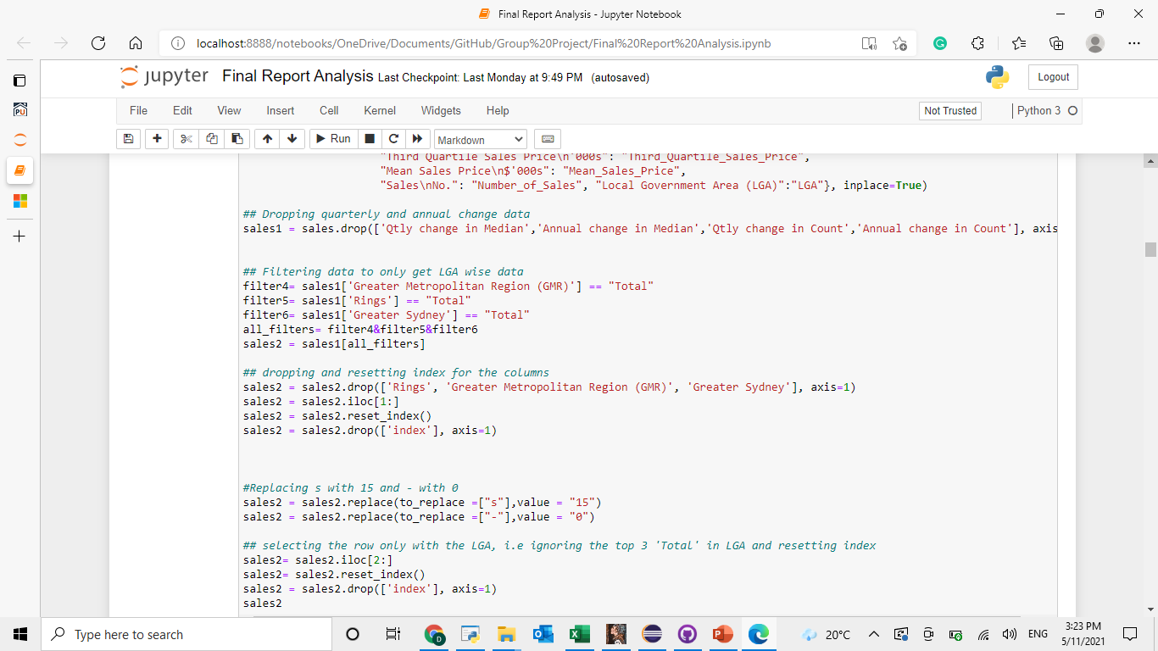
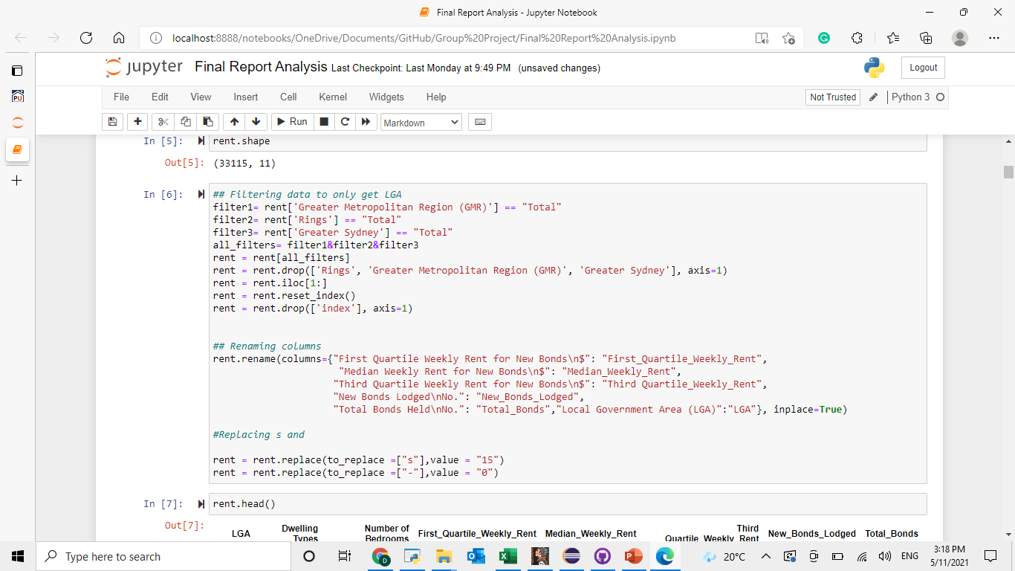
DATA FORMAT, CLEANING AND MANIPULATION
Sales
Rent

Slide 7
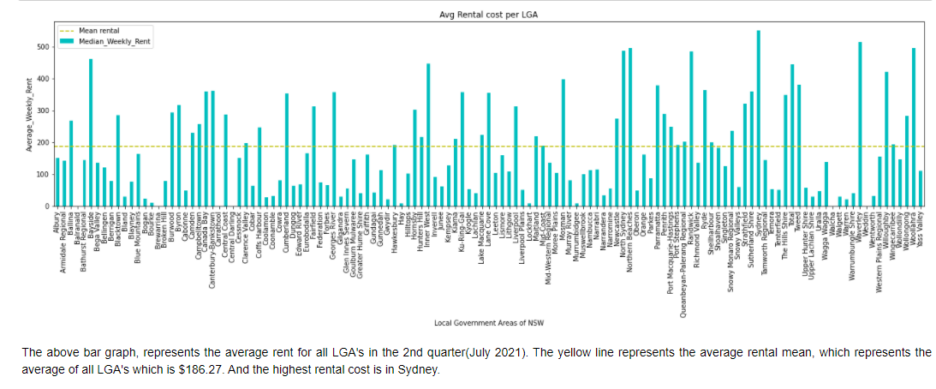
Average rental cost across LGA’s

Slide 8
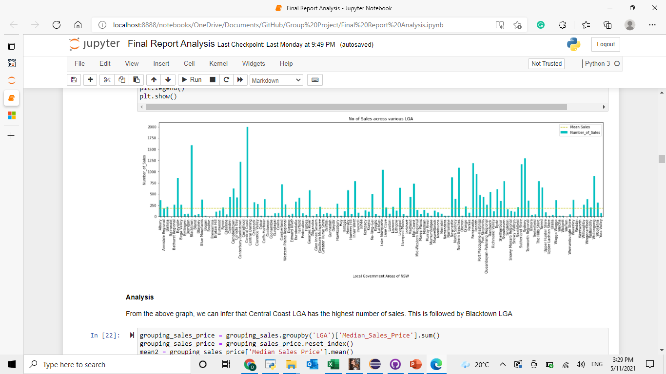
Number of house sales across LGA’S
From the graph, we can infer that Central Coast LGA has the highest number of house sales, followed by Blacktown LGA.

Slide 9
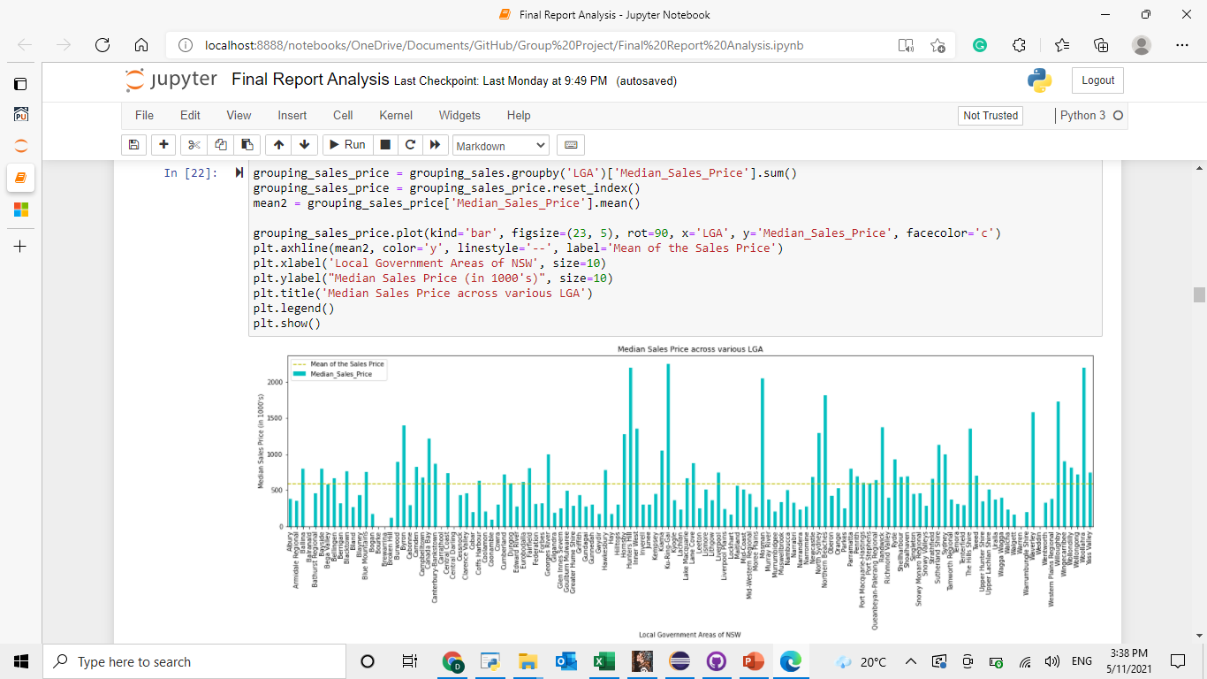
Median sales price across LGA’s
From the above graph, we can infer that Ku-Ring-Gai has the highest house prices at almost 2 Million AUD followed by Hunter's Hill, Woolahara and Mossman. The Average house price is around $600,000

Slide 10


Income and Crime Data
Income Data
Crime Data
Income data represents number of earners with their total income in all LGA’s in NSW.
Crime data consisted of crimes from Jan 1995 till present. But for this analysis crimes are considered from Jan to July 2021.

Slide 11
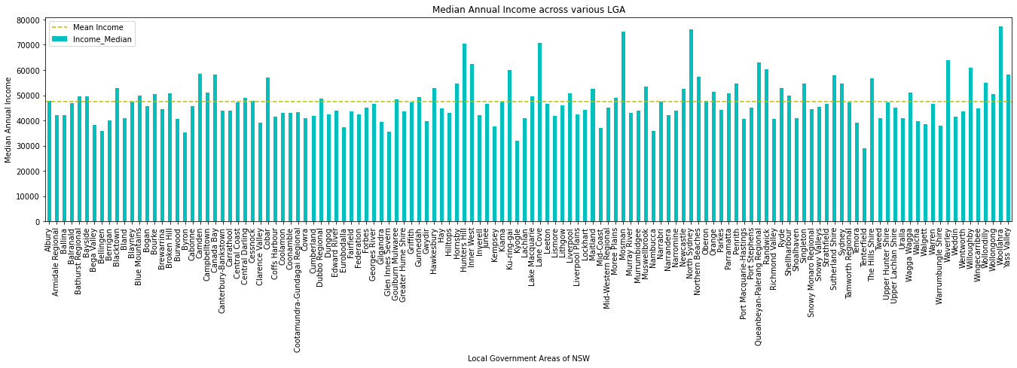
The above bar graph depicts the average income across all LGA’s in NSW. So from the graph, Wollahra, North Sydney, and Mosman have the highest average annual income of around $70000. And the average income of NSW (depicted by the yellow line) is $48000.

Slide 12
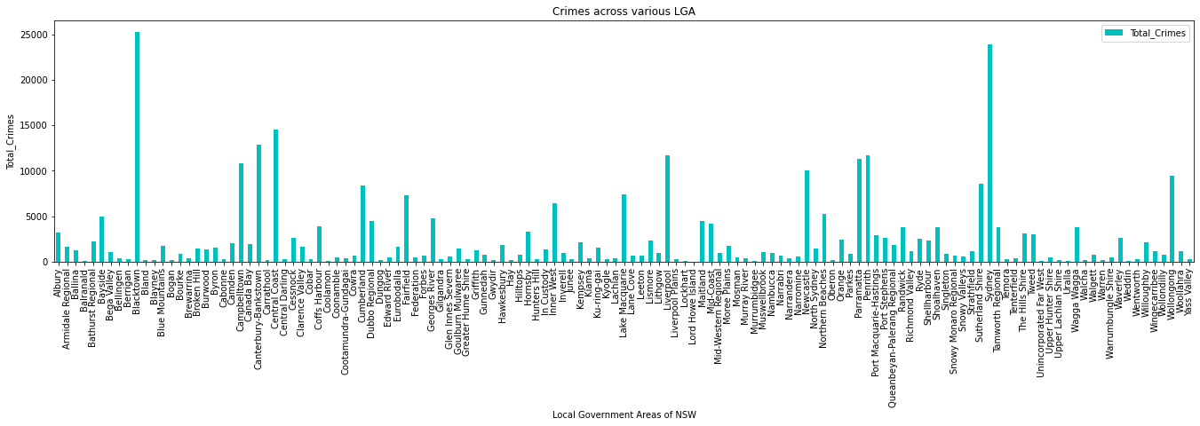
Income And Crime Data
MERCURY
VENUS
From the above bar graph, the maximum number of crimes are observed in Blacktown and Sydney.

Slide 13
Linear Regression
All the above datasets are combined to predict the number of house sales for all LGA’s.
Linear Regression represents the relationship as a straight line.
The independent features used for linear regression are Median Income, Total Crimes, Number of Earners, and Median Sale.
The above-mentioned features are considered to be the best in predicting the number of house sales on the basis of RFE technique.

Slide 14
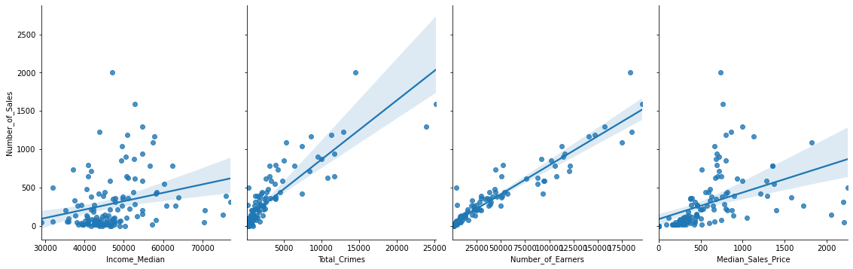
Correlation
The above graph shows the pairwise correlation between dependent and independent variables used for predicting the model. The graph depicts total crime and number of earners have positive linear relationship, the data points are quite fit with the linear regression line, whereas the data points for other two features namely income median and median sales price are scattered. So, from the correlation table and graph all features have positive linear correlation with number of sales but Total crime and Number of Earners have perfect positive linear relationship with number of sales.

Slide 15
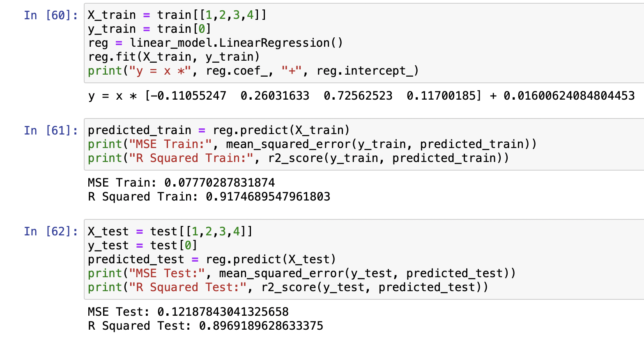
Training and Testing Linear Regression
Interpretation
As total crime and number of earners are almost perfectly correlated with the number of sales. So, these two features highly determine the sales of houses.
The model is divided into training and testing tests as it provides a better performance idea of the model.
Our MSE and R² on the training set is ideal as MSE is low and R² value is 91.75%
Our MSE and R² results for the test set are also close to the train set. The test set evaluates the fit machine learning model. As R² is 89.69% it means that the model is good at predicting the target value.

Slide 16
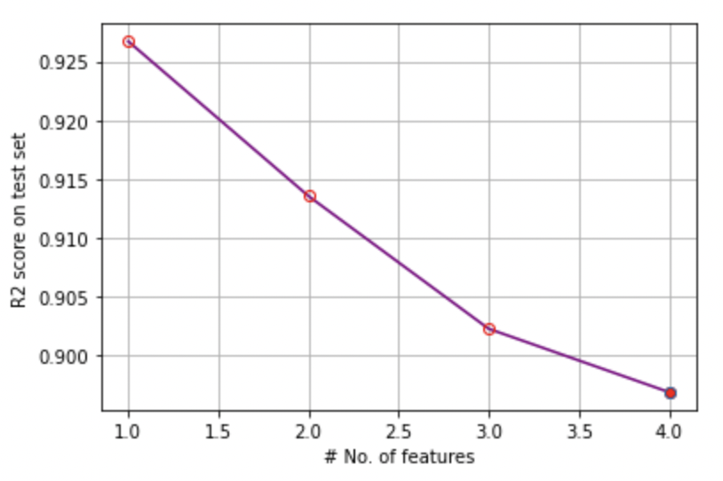
APPLYING RFE TO THE LINEAR MODEL
Here, we are evaluating RFE feature selection algorithm on the dataset.
We can see here that the R square score decreases as we increase the number of features, implying that new the addition of new features doesn’t enhance the model performance.
When we check for the order of these features, we can see that ‘Number of Earner’s is the best predictor for ‘Number of Sales’, followed by Crime Rate and Median Sales Price.

Slide 17
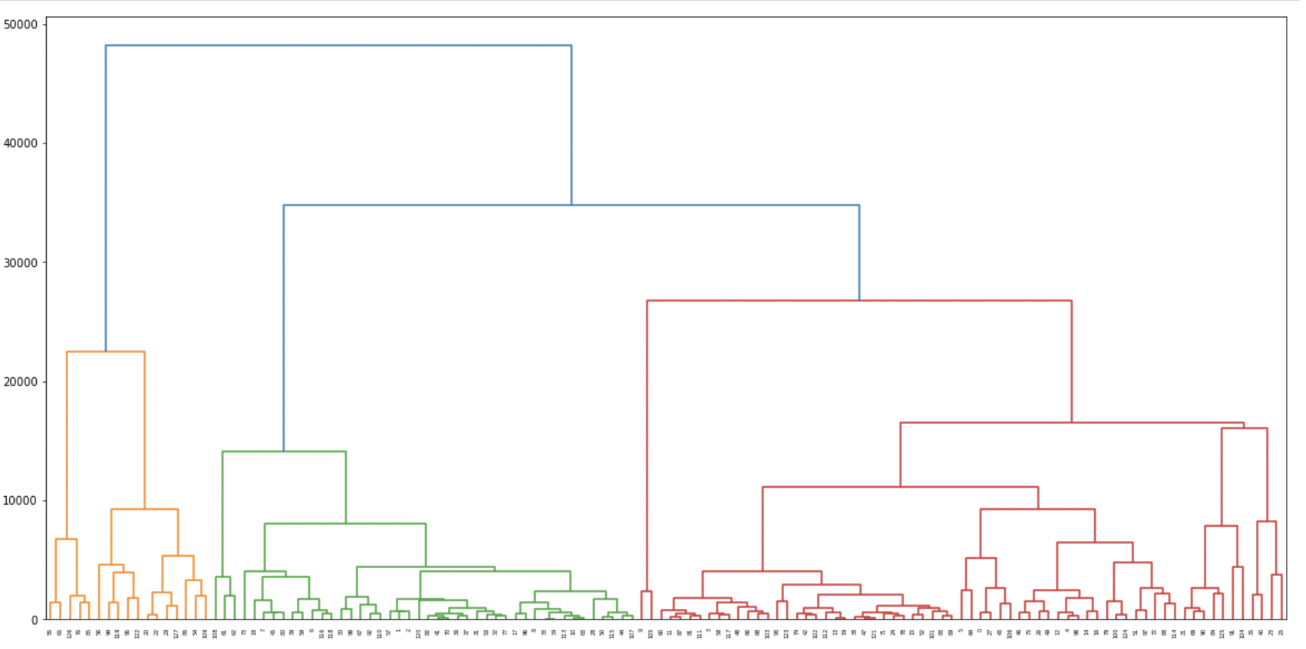
K-MEANS CLUSTERING
We use the K-Means Clustering algorithm to group LGAs in the form of clusters with similarity in terms of Rent cost, Sales cost etc.
Here we use the Hierarchical Clustering, which produces a tree-based hierarchy dendrogram. This way we have predetermined the number of clusters (k).
We have determined that we would be needing 3 clusters to perform our analysis.

Slide 18
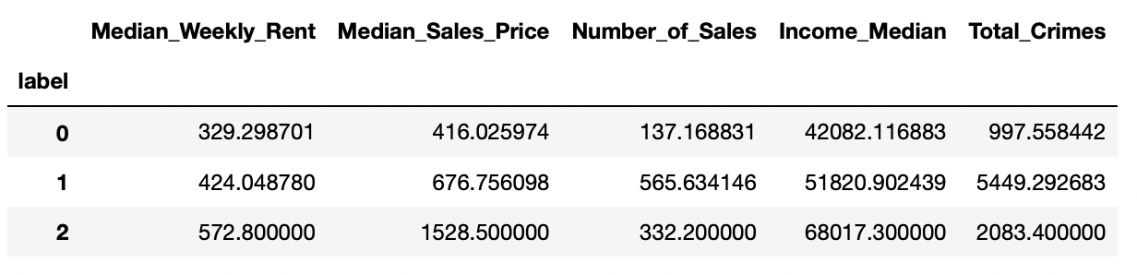
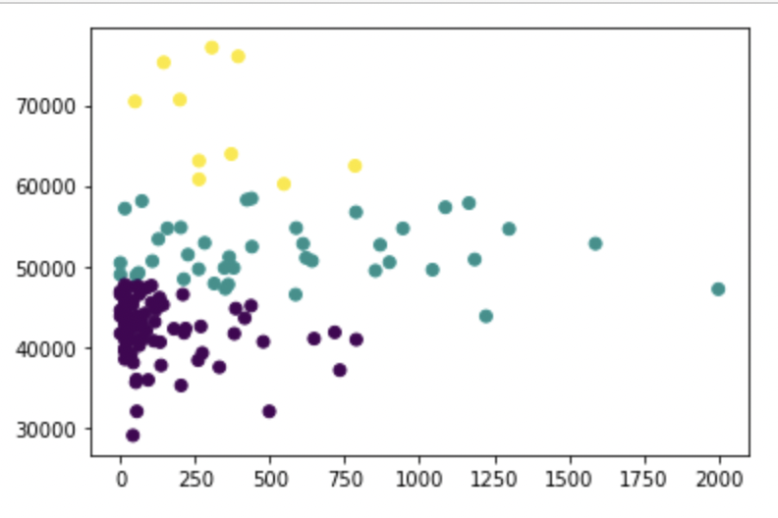
K-MEANS CLUSTERING
We partition the data into k clusters, each with a mean value. Each LGA in the cluster is placed in the cluster closest to the cluster’s mean value.
Here, ‘Income Median’ and ‘Number of Sales’ are divided with respect to
the 3 clusters we distributed the dataset into. We
see clusters of LGAs with moderate income have
highest number of house sales.

Slide 19
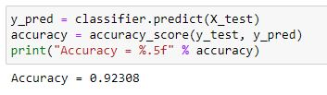
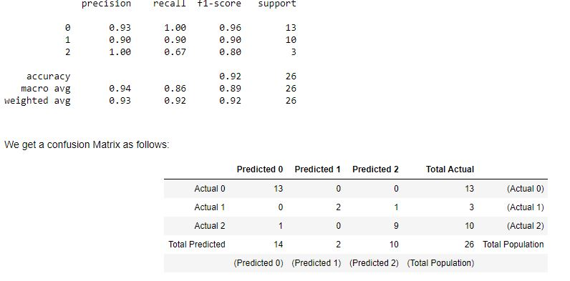
K-Nearest Neighbors
Dividing our dataset into train and test, after training our model, we get an accuracy score of 0.92 on our test data
Precision for each class signifies the ratio true positives (correct classifications) to the total predictions for that class. For our entire model we see a Precisions core of 0.94.
Recall is defined as the ratio of true positives to the sum of true positives and false negatives. For our model we see a Recall score of 0.86.
The F1 is the weighted harmonic mean of precision and recall. The closer the value of the F1 score is to 1.0, the better the expected performance of the model is. Our model has a f1-score of 0.89.

Slide 20
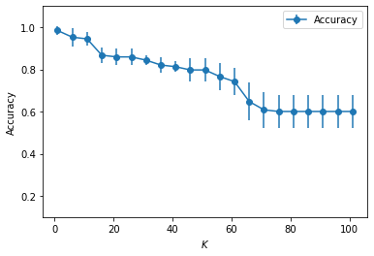
Cross Validation using Grid Search

Slide 21

Conclusion
We were able to fit a linear regression model predicting the number of house sales.
Clustered the LGA’s into 3 groups -> ‘Lower Middle Class’, ‘Upper Middle Class’ and ‘Rich Class’.
Our classification model based on this clustered data also has a high accuracy.
Future Improvements:
Adding more features that do affect sales and rent data.
Adding more data.

Slide 22
References
https://www.facs.nsw.gov.au/resources/statistics/rent-and-sales/dashboard
https://www.abs.gov.au/statistics/labour/earnings-and-work-hours/personal-income-australia/latest-release#data-download
https://www.bocsar.nsw.gov.au/

Slide 23
THANK YOU

